Slide 1

Prepared by Logical Operators
for COSC 3F00
February 27th, 2014

Slide 2
Review
Using Agile principles
Split project into time-boxed iterations
Created and prioritized the list of features
Pulled highest priority features into first iteration

Slide 3
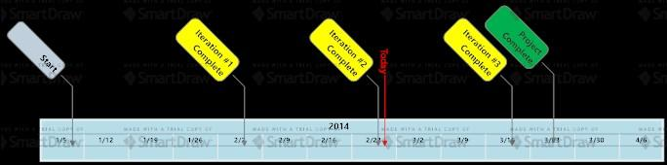
Project Timeline

Slide 4
Iteration #2 Goals
Pulled the next set of features from the backlog
Complete the offline version of the game
Include “New Game” as well as “Save/Resume Game” features
Initiate artificial intelligence integration
Improve project progress tracking

Slide 5
Planning
All tasks are tracked in GitHub
Began with 6 high level use cases which we broke down into project tasks
Analysis, design, construction and testing of the use cases spawned many subtasks eventually leading to a total of 32 project tasks

Slide 6
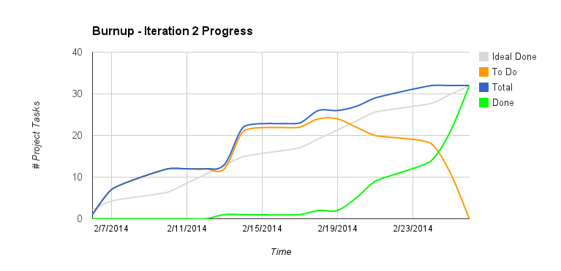

Slide 7
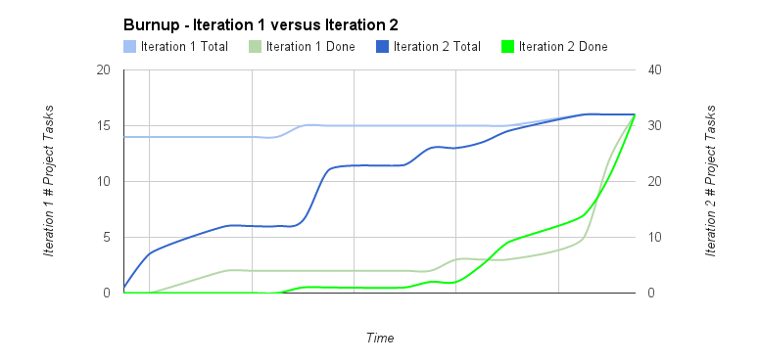

Slide 8
Observations
Iteration 2 was 1 week shorter
Less effort needed to be dedicated to learning tools
Some improvement in progress tracking was observed
Goal for next iteration will be to trend as closely as possible to the “Ideal Done” line

Slide 9
Other Iteration Activities
GitHub used to house all artifacts, source code and automated tests
Analysis and design artifacts followed conventions from iteration #1
Construction and testing was done using AndroidStudio
travis-ci.org used for continous integration

Slide 10
Ready For A Demo?
Agile Principle #7:
“Working software is the primary measure of progress.”
Source: agilemanifesto.org/principles.html

Slide 11
Demonstration

Slide 12
Next Iteration Goals
Complete AI integration
Implement network capabilities for online features and game play over the internet

Slide 13
Feedback?
Q&A

Slide 14
Thank you

